Slide 1
KIET Group of Institutions, Ghaziabad
MENTAL HEALTH AWARENESS
Group ID: PCSE25-21
Team Leader: Disha Sehgal Semester : 8 Department: CSE
Group Member: Disha Sehgal Semester : 8 Department: CSE
Group Member: Charu Singh Semester : 8 Department: CSE
Group Member: Diya Bansal Semester : 8 Department: CSE
Name of Guide : Dr. Parita Jain
Date of Presentation : 24 May 2025
1

Slide 2
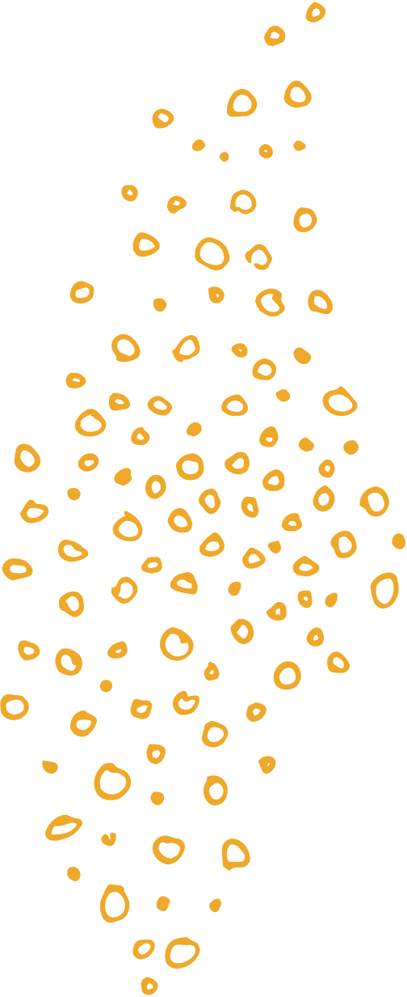

Mental Health Awareness using ML
CO’s
To Analyze and describe the problem domain.
2. To formulate clear work plan and procedure.
3. To describe and evaluate both generic and specific skills.
4. To design and apply modern tools for designing and drafting.
5. To design report and presentation.
Outcome of the Project- Research Paper
SDG
SDG 3: Good Health and Well-being
SDG 4: Quality Education
SDG 10: Reduced Inequalities

Slide 3

Introduction
Mental health is an essential aspect of overall well-being, yet it often goes unrecognized or untreated due to stigma, lack of awareness, and limited access to care. Our final year project, Mental Health Awareness Using Machine Learning, aims to bridge this gap by leveraging intelligent systems to promote self-awareness, early detection, and emotional regulation. By integrating three core components—stress prediction, emotion detection, and a mood diary—our system empowers individuals to monitor their mental state using data-driven insights. Through machine learning algorithms like XGBoost and CNN, combined with an intuitive user interface, the platform encourages proactive mental health management and supports informed decision-making in daily life.

Slide 4
Problem Statement
Stigma Around Mental Health: Many people avoid seeking help due to fear of judgment and societal stereotypes.
Limited Access to Mental Health Services: There is a shortage of affordable and nearby mental health facilities, especially in rural areas.
Financial Constraints: High costs of therapy and lack of insurance coverage make mental health care unaffordable for many.
Lack of Awareness and Early Diagnosis: People often fail to recognize early signs of mental illness, leading to delayed treatment.

Slide 5

Project Objectives
Stress Prediction
Emotion Detection
Mood Diary

Slide 6

Stress Prediction
Uses physiological and behavioral data (e.g., heart rate, sleep duration, oxygen levels).
Implements the XGBoost algorithm for accurate stress level classification (low, moderate, high).
Helps identify early signs of stress and enables timely self-care or intervention.
Provides fast and reliable output within seconds of data input.

Slide 7

Emotion Detection
Uses real-time facial expression recognition through a webcam or uploaded image.
Applies a Convolutional Neural Network (CNN), specifically MobileNet, for emotion classification.
Detects seven key emotions: anger, disgust, fear, happiness, sadness, surprise, and neutral.
Enhances user awareness of emotional responses in different situations.

Slide 8
Mood Diary
Offers a simple web interface for users to log their daily mood (scale of 1 to 5).
Allows optional input for notes, sleep quality, and activities.
Visualizes mood trends using monthly mood charts.
Helps users reflect on patterns and triggers affecting their emotional well-being.

Slide 9

Key Components-Stress Prediction
Feature Engineering:
Selected physiological features: snoring range, respiration rate, body temperature, oxygen saturation, heart rate, and sleep duration.
Most influential features: heart rate, respiration rate, and sleep duration.
Less impactful features: snoring range and body temperature.
Model Selection:
Chose XGBoost for its high accuracy and robustness against overfitting.
Learns iteratively from mistakes to improve predictions.
Performs well on large, complex datasets — ideal for stress prediction tasks.

Slide 10

Key Components- Emotion Detection
Real-Time Face Detection (YOLOv5):
Webcam captures user’s face in real time.
YOLOv5 detects and extracts faces in under 20 milliseconds per frame.
Handles different lighting and background conditions; prompts users to adjust if needed.
Emotion Classification (MobileNet CNN):
Cropped face images are resized to 224×224 pixels and normalized.
MobileNet CNN classifies emotions into seven categories: anger, disgust, fear, happiness, sadness, surprise, and neutral.
Prediction completes within 1–2 seconds after image capture.
Data Augmentation for Accuracy:
Used to simulate real-world scenarios and improve model robustness.
Techniques include:
Horizontal flipping
Zooming
Shearing
Slight rotations
Brightness adjustments
.

Slide 11

Key Components- Mood Diary
User Interaction and Logging:
Users log daily mood on a scale of 1 to 5 via a simple web interface.
Optional fields to note events, activities, or emotional triggers.
Entries are stored in real time using Firebase.
Visualization and Feedback:
Mood data is visualized using heat maps and monthly charts.
Color intensity reflects mood levels: darker = low mood, lighter = better mood.
Visualizations update instantly to help users identify emotional patterns and trends over time.

Slide 12
RESULT AND DISCUSSION
A. Stress Prediction
Accuracy: 82.74% – Effectively classifies stress levels (low, moderate, high).
Precision: 83.10% – Reduces false positives when identifying high stress.
Recall: 82.74% – Accurately identifies true high-stress cases.
F1-Score: 82.65% – Balanced performance between precision and recall.
Model Choice: XGBoost was selected for its speed, accuracy, and resistance to overfitting.
Effectiveness: Detects subtle stress indicators like sleep deprivation, oxygen levels, and heart rate.
Comparison: Outperformed other models such as Decision Tree, Random Forest, and SVM in all metrics.
.

Slide 13
B. Emotion Detection
Accuracy: Achieved 72% accuracy using MobileNet CNN on emotion classification.
Emotion Categories: Detected 7 emotions — anger, disgust, fear, happiness, sadness, surprise, and neutral.
Model Training: Training and validation accuracy showed consistent improvement across epochs.
Real-World Readiness: Used augmented datasets to improve performance under varying conditions.
Improvements Suggested:
Fine-tuning MobileNet architecture.
More advanced augmentation.
Larger and more diverse datasets.
Exploring ensemble learning methods.
.

Slide 14
C. Mood Diary
User Engagement: Simple, user-friendly interface encouraged daily mood logging and consistency.
Mood Scale: Users rated daily moods from 1 to 5, with optional notes for context.
Visualization:
Heat maps showed mood intensity (dark = low mood, light = better mood).
Monthly charts helped track emotional trends.
Personal Insights: Enabled users to find correlations (e.g., high workload linked with low happiness).
Intervention Support: Suggested relaxation techniques during periods of high stress based on patterns.
.

Slide 15
Ethical Considerations
Privacy of Sensitive Emotional Data: Emotional and mental health information is highly personal. The system must ensure this data is not exposed, shared, or misused in any way.
User Consent and Transparency: Users must be clearly informed about what data is collected, how it will be used, and must give explicit consent before participating.
Data Encryption and Secure Storage: All user data should be encrypted during transmission and securely stored in databases to prevent unauthorized access and cyber threats.
.

Slide 16
Conclusion
Developed a CNN-based real-time emotion detection system achieving 72% accuracy.
Implemented an XGBoost-based stress prediction module with 82.74% accuracy using behavioral traits.
Integrated a mood diary feature that helps users log emotions and receive personalized feedback, encouraging self-reflection and emotional regulation.
The system effectively monitors mental health through multiple complementary approaches.
Provides a solid foundation for future enhancements to improve accuracy, personalization, and real-time responsiveness.
.

Slide 17
Future Scope
Wearable Device Integration: Use data from smartwatches and fitness bands (heart rate, sleep, activity) for more accurate, real-time stress and emotion monitoring.
Enhanced Personalization: Incorporate user-specific behavioral and physiological data to deliver tailored feedback and advice for better emotional and stress management.
Blockchain Integration: Enhance data security and privacy through blockchain technology, addressing ethical concerns in AI-based mental health diagnostics.
Adaptive System: Develop a more intuitive system that adapts over time to user needs, enabling improved understanding and management of mental well-being.
.

Slide 18

Thank You!

